Slide 1
An investment in knowledge always pays the best interest.
Benjamin Franklin
GTS 3DLevelScanner™
Changing the market from level to volume
Sales North America
Innovating and Pioneering 3D Level
and True Volume Measurement
of Solid Materials in Silos and Open Bins

Slide 2
Main topics of discussion
GTS and APM's technology
a) How does it work
b) Main benefits and advantages
Where does it work
Why customers buy our products

Slide 3
Agenda
Background
Technology in a Nutshell
Inventory Management and Control
Success Stories
Summary of Add Values and Benefits for the End-User

Slide 4
Background

Slide 5
Established in 2005
Mission: To revolutionize the bulk solid inventory measurement from single point level to 3D mapping volume measurement, thus allowing GTS’s customers to gain considerable improvements in their inventory management and control across the supply-chain.
Movie

Slide 6
Awarded the prestigious Emerging Technology Company of the Year Award for 2007 by the Israeli Ministry of Industry & Trade.
Recognized as the Breakthrough Product of 2010 by the Processing Magazine (USA) – December 2010
Worldwide robust channel of distributors and partners
Over 9,000 3DLevelScanners installed

Slide 7


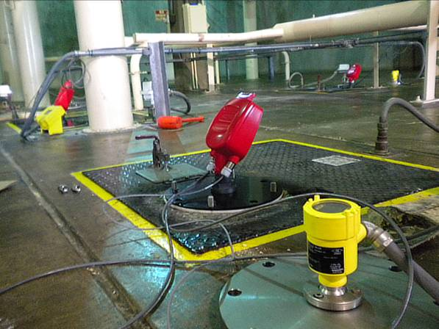
Rice Silo Installation

Slide 8
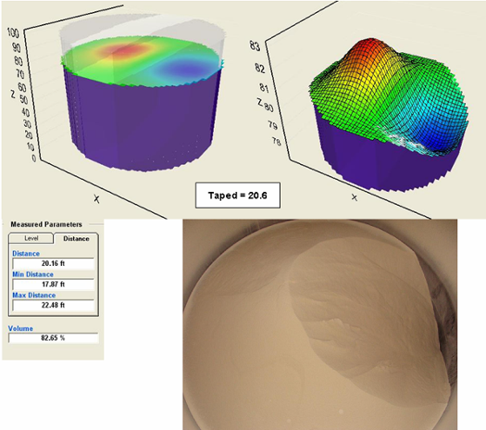
3D Visualization During
Empty Cycle: #1
Inset photo shows bin contents at time of measurement.
Single point measurement devices would not reflect this irregularity in material surface.
VOLUME: 82.65%

Slide 9
Technology in a Nutshell

Slide 10
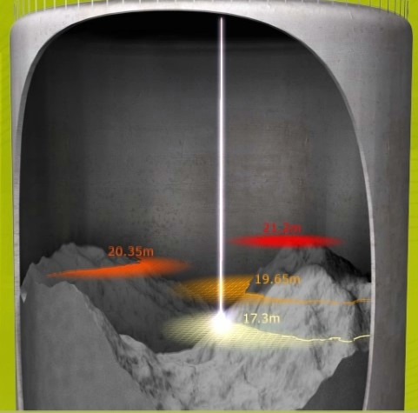
Standard Continuous Level Measurement Technologies
Time of flight concept

Slide 11

GTS Technology Concept
Wide low frequency acoustic beams to cover the entire surface

Slide 12
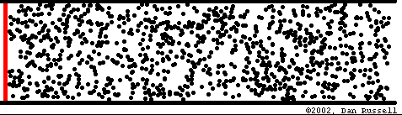
The Effect of Dust
Sound is a pressure wave
Dust particles and humidity in the air attenuate the wave energy
Attenuation grow sharply over 5KHz
Animation courtesy of Dr. Dan Russell, Kettering University
Low freq. => Effective dust penetration

Slide 13

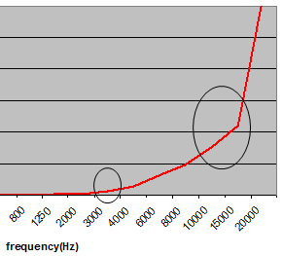
GTS Technology Concept Advantages
Low frequency has 3 major advantages:
  Very low attenuation
  Easy penetration through dust
  Wide angle that can cover the entire surface!

Slide 15
GTS Innovative Patented solution

Slide 16
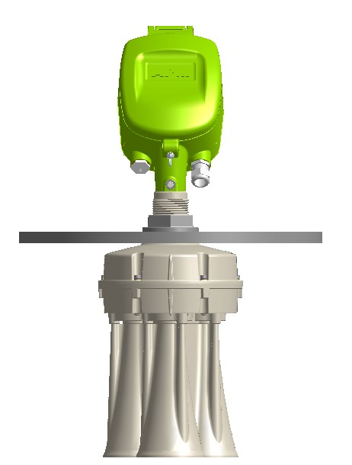
GTS Innovative Patented solution

Slide 17
Inventory Management and Control

Slide 18
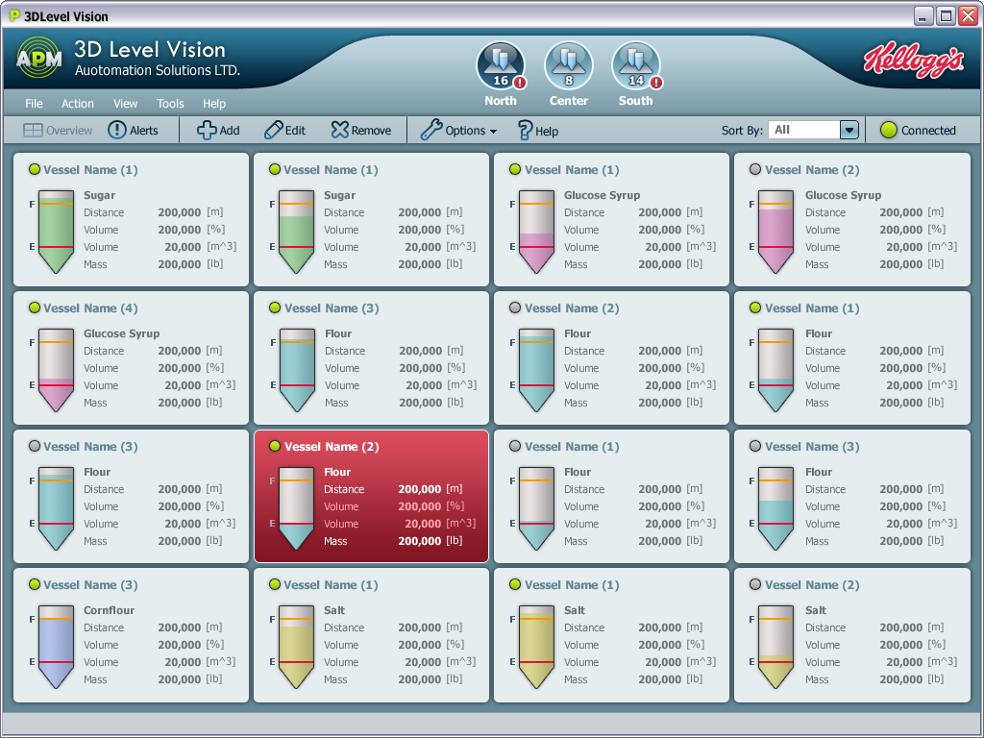

3D MultiVision Software3D

Slide 19
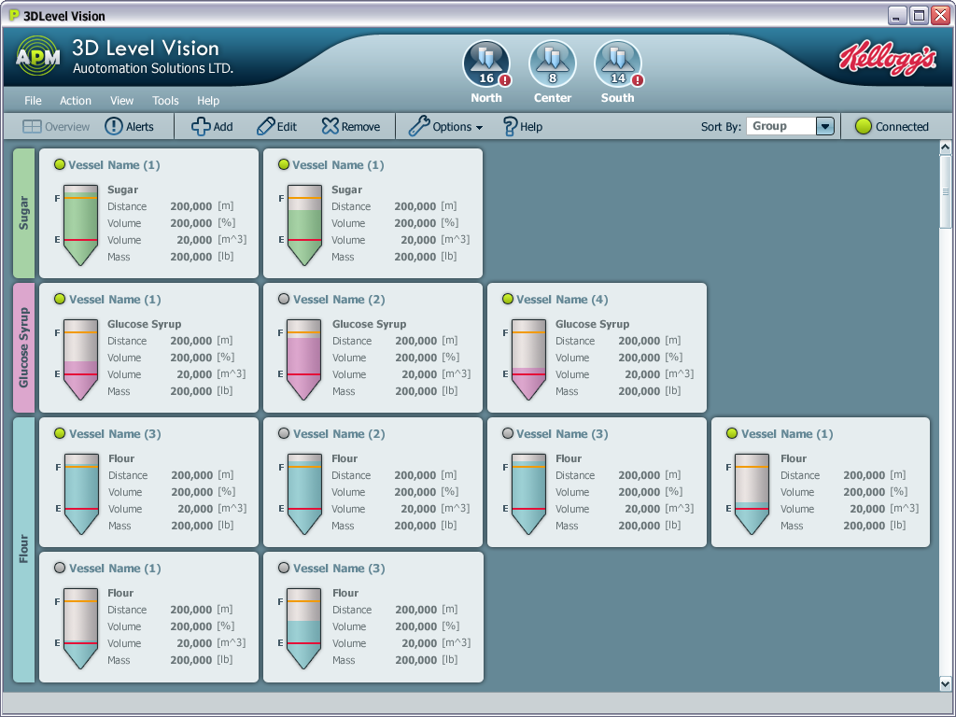

3
100
625
7
61
523
18
34
212
4
90
543
20
12
134
3
100
625
3
100
625
3
100
625
20
12
132
21
10
123
12
54
311

Slide 20
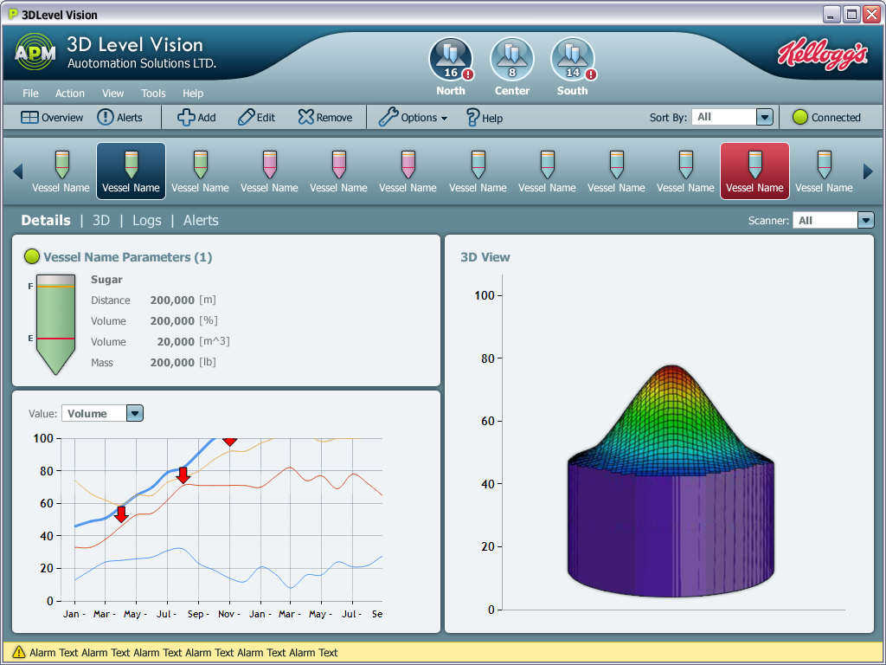

Sort by: חסר
3
100
625

Slide 21
Financial Aspects of Inventory
Inventory costs money
Carrying and handling of inventory costs money
Continuous accurate inventory in-process measurement during manufacturing is essential for efficient operation and yield improvement
Efficient ordering saves money
Safety stock costs money and can be reduced by accurate inventory measurement
Accurate inventory measurement is required for periodically accounting
Accurate Inventory Measurement is the basis of efficient operation and cost reduction

Slide 22
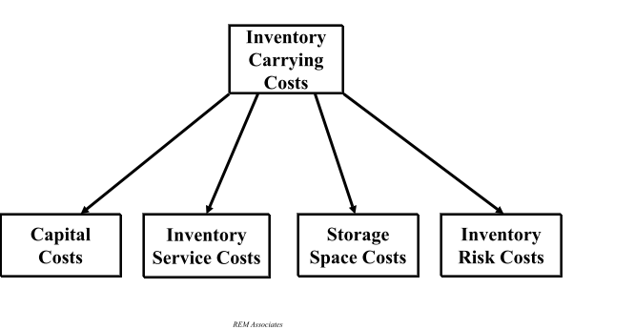
What Makes Up Inventory Carrying Costs?
Inventory carrying costs are made up of the following:

Slide 23
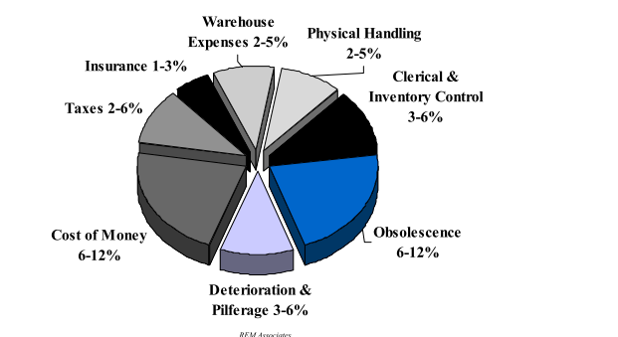
Inventory Carrying Costs In Summary
Total inventory carrying costs can be broken down by
* Richardson, Helen: Transportation & Distribution, “Control Your Costs then Cut Them” December, 1995

Slide 24
Continuous Accurate Measurement of the amount and condition of your inventory
Substantial Cost Savings Across the Supply-Chain

Slide 25
Summary of Benefits for the End-User

Slide 26
Maintenance Benefits
  Early warning about adhesion of materials to the walls of the silos
  Self-cleaning
  Operates in harsh and dusty environments
  Avoids over-flow during filling and its consequences: materials loss, environmental damage
  Also measures the volume of materials stored in open bins/warehouses
Notes:
26

Slide 27
Inventory Management and Control Benefits
Assist to better control manufacturing process and to improve production yield
Decreases extra safety stocks
Lowers costs by ordering materials only when they are needed
Eliminates production stoppages caused by lack of materials in process
Optimizes the right mix of materials used in the production process
Reduces required storage (volume) capacity
Improve accounting procedures and decrease its related expenses
Notes:
27

Slide 28
GTS Channel
Our Partners
North America | Global Technology Systems (GTS) | France | Berthold France SAS
 |  | Germany | REMBE® GmbH Safety + Control
 |  | Israel | United Instruments Ltd.
Mexico | Inova Control SA de CV | Italy | Berthold Italia Srl
South Africa | Allpronix | Netherlands | Istec International BV
 | Cape Instruments Services | Romania | Syscom
Turkey | Geotek | Russia | SKP Jsc Spetscomplektpribor
Spain | Iberfluid | Australia | HMA – Measurement Resources
 | GES/ Siemsa Control | South Korea | Yeo Myung System
Norway | Max Sievert | Brazil | Conaut
Poland | Newtech Engineering | India | EIP Enviro Level Controls Pvt Ltd
Croatia | OMIKO | China | Jinde
Finland | SINTROL OY | Austria | Stip Mess & Projekttechnik
Hungary | Volent Budapest KFT | Sweden | Wesmar (Tilquist)

Slide 29


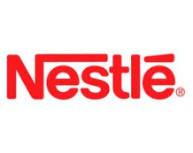























Selected Customers

Slide 30
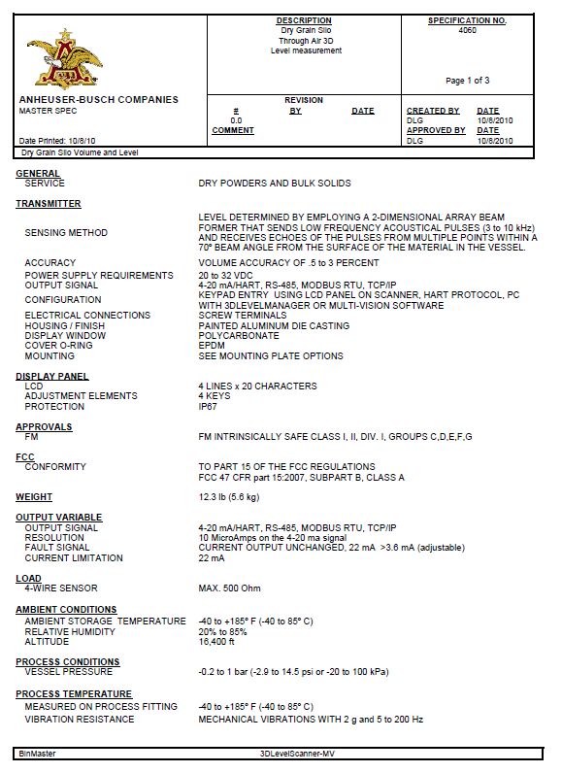
Authorized Vendor with Master Spec Number for the 3DLevelScanner sensor dry grain silo volume measurement instrument system.
Notes:
30

Slide 31
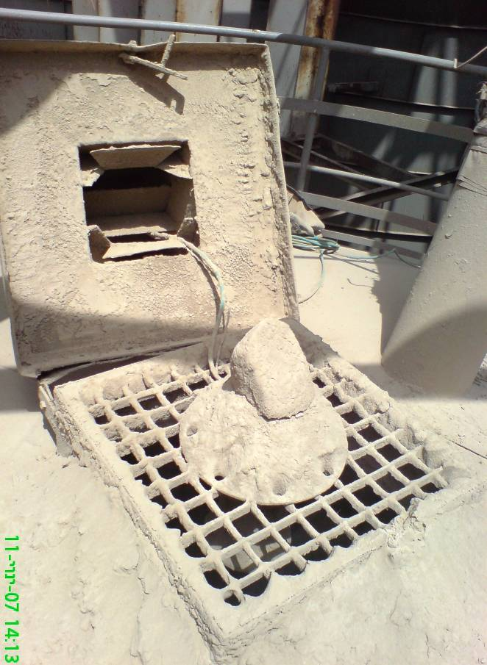
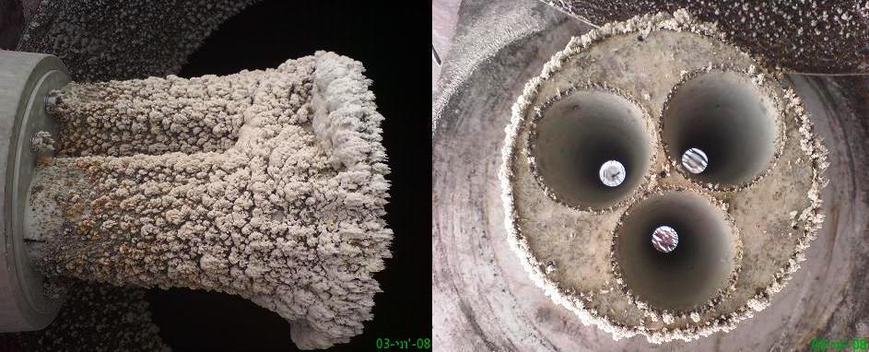
Example of Self-Cleaning in Flour Application
3DLevelScanner covered with flour

Slide 32
What do customers want to control?
Ordering point
Order size – quantity
Weight of incoming deliveries
Production, consumption and material quality delivered by each supplier
Required quantities of safety stock

Slide 33
Market needs
Monitoring material usage
Documenting each transaction to reduce loss of material
Reducing cost of maintenance
Remote support mechanism

Slide 34
Market needs
Optimizing storage capacity –
utilizing 3D visualization capabilities
Ensuring continuous supply of raw material into the production process
Centralized material planning from different silos and different sites

Slide 35

Thank You!
GTS, Inc.
PO Box 799, Shalimar, FL 32579
Phone: 850-651-3388
Fax: 850-651-4777
Email: info@onthelevel.com
Website: www.onthelevel.com
Notes:
35

Slide 36

Phoenicia America-Israel (Flat Glass) Ltd
Israel
Flat Glass Production

Slide 37
Application Overview
Silos sizes are 5-7m wide and 19m high
Stored material price is between $400-600 /Ton
Total number of silos is 10
All units installed are M type 3DLevelScanner
The customer needed an accurate volume measurement system to control his inventory as the precision is a very important fact for the entire production process
1 unit was installed for 3 weeks testing and approved by the customer for his needs

Slide 38
The Problem
Previously used technology - Radar
Only used for indicating approx. level
Due to the process, customer looked for high accuracy volume measurement, to control the inventory at all time in order to be able to control continuous production
When the silo is empty, they need to be sure that there is no material left and this could not be indicated by the radar

Slide 39
GTS Solutions
The Customer decided to install GTS 3DLevelScanners type M on all of his silos
The system now provides him with high accuracy volume measurement of his contents, eliminating the need of physical observation of the silos and erratic calculation occurred due to radar estimations
Benefits for the customer
  1. high accuracy volume measurement
  2. true knowledge of inventory status
  3. no need for physical observation of the silos

Slide 40
My Relationship With The Customer
We targeted Phoenicia and approached them as they are the biggest glass manufacturer in Israel with 80% export
I contacted the Hot End Manager, who is in charge of the production process and therefore for the raw materials being used

Slide 41

Carmel Olefins
Israel
Polypropylene pellets production

Slide 42
Application Overview
Material
  Polypropylene Pellets
  Approx. 0.8 g/cm³
  Approx. 1800 USD/ton
Silo size:
  diameter 6.5m,
  height 21 m,
  total capacity of 650 tons
Total value of material in silo : 1.17 million USD
Number of silos on site : 26
Previously used technologies: radar, ultrasonic, guided wave radar

Slide 43
The Problem
All of the other technologies had different problems such as high cost of maintenance, inaccurate readings, bad tractability
The customer looked for a solution that will reduce maintenance costs, will generate accurate volume readings in order to follow both the filling process from the production line and the emptying to trains and trucks
There was a need for a reliable system that could be counted also for calculating the volume of stored inventory

Slide 44
GTS Solutions
GTS installed 6 M units
Benefits for the customer
  High accurate volume readings of the content
  Reliable and continuous measurement
  Elimination of maintenance costs to nearly 0
The customer placed an order to equip all silos on site with GTS type M 3DLevelScanner

Slide 45
My Relationship With The Customer
As the biggest and only producer of polypropylene with silos of over 5 m diameter, and high cost material stored, the need looked to be important
The approach was made both through the Instrumentation Manager and the Plant Chief Engineer

Slide 46


Berthold Italia S.r.l.
Italy
Salt Application
Seik

Slide 47


Application Overview
Material : Salt
Density : 2,2
Price per ton : not known
Silo size : 380m³
Silo material : wood
Silo dimension : max diameter 5 meters
max height 18 meters
Number of silos : more than 2000 only in Europe
Old equipment : Radar
Problem : Measurement not reliable during filling and empting phase
47

Slide 48

The Problems
Due to several problem with the standard equipment (radar, ultrasonic, chord…) caused by the type of material and by the profile during the different phases of the storage, the customer was using the standard load cells
  Unfortunately the price of the load cells is not so cheap and, in order to re-sell they need to buy a minimum quantity of 100 units even if they need only a few pieces
Second problem was the maintenance.
  These types of silos are normally installed alone and nobody can go there only to check if the level measurement is working properly, so strong equipment is really important to avoid any unnecessary trips
Last but not least was the orders to the material supplier
  The customer needs accurate inventory
  management inside the silo to prevent ordering
  before product is needed but to ensure ordering in time
  to prevent financial penalties of untimely ordering
48

Slide 49
GTS Solution
Ability to check the volume of the material at any moment and in any process condition
Ability to know, by a special calibration curve, the weight of the product inside the silo
Ability to see the disposition of the product inside the silo
Ability to control also the open
area storage with the same
equipment
49

Slide 50
My Relationship With The Customer
The potential from the sales point of view is really huge
In Italy alone they have more than 250 potential installations
Outside Italy the potential will be more (something between 300 to 400 installation)
The contact was collected by internal research
The General Manager of the company was involved only in the first step
Since then all the technical issues and even the decision to try the equipment was made by the Technical Director
50

Slide 51



AZUCARERA EBRO
SPAIN
SUGAR SILO
IBERRFLUID INSTRUMENTS

Slide 52


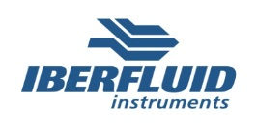
Application Overview
Material
  Sugar
  Density: 0,800 gr/cc
  Price: 845 € / tonne

Slide 53
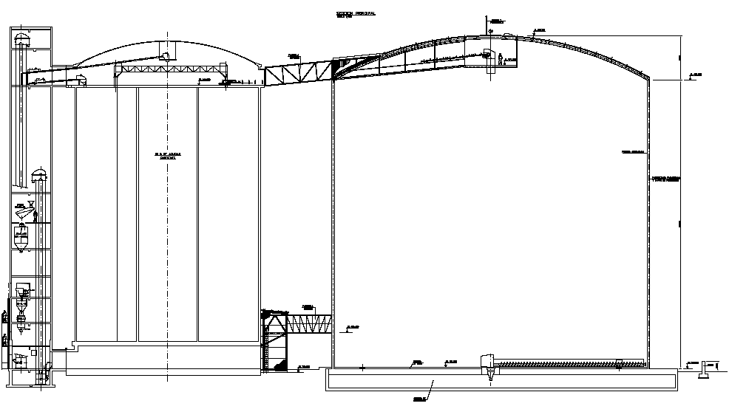
Application Overview
Silo

Slide 54
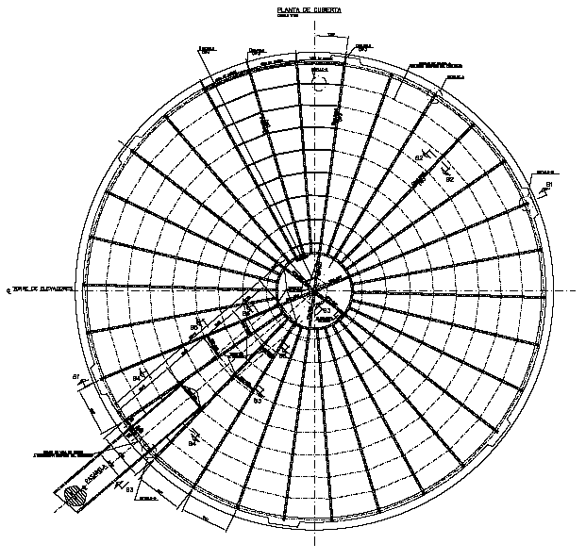
Application Overview
Silo
Height: 51 meters
Diameter: 48 meters

Slide 55
The Problem
Why was the customer looking for new measurement solutions?
Solution to achieve a reliable & accurate volume measuring system which can work in this huge application under dusty environment
Was volume measurement needed?
Must control their inventory and produce governmental accurate volume reports on a periodically basis
Was material surface profile important?
Very huge dome – more than 65,000 tons of sugar

Slide 56
The Problem
Was real time consumption important?
At any given time must be able to know the precise inventory status
Did material create bridges, buildups?
Sugar tends to stick
Was there maintenance problems with old equipment?
There is no other existing solution for this kind of application. No devices which can solve the problem of accurate volume and dust penetration

Slide 57
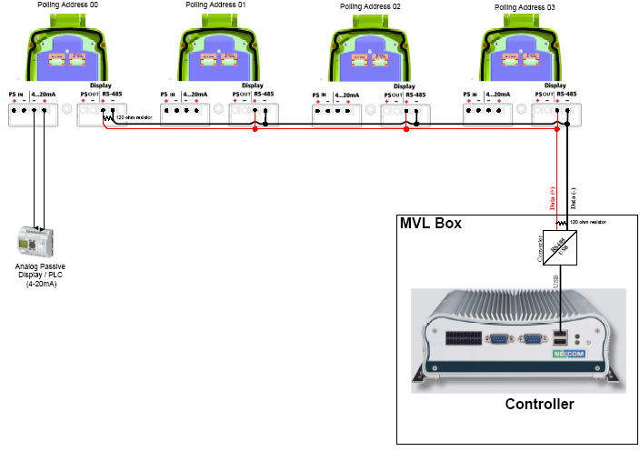
GTS Solutions
APM solution - configuration

Slide 58
Who is your inside buyer of GTS equipment?
Maintenance department
Purchasing
Materials planning (MRP)
Finance
Plant production manager
IT department
General manager

Slide 59
What drives the purchase decision?
Maintenance / instrumentation team
  Stability
  Reliability
  Real-time measurements
  Low-maintenance costs
  Ease-of-use

Slide 60
What drives the purchase decision?
Purchasing
  Accuracy
  Reduce ordering costs
  Minimize risk of extra inventory
  Minimize risk of inventory shortage

Slide 61
What drives the purchase decision?
Finance
Save money by reducing costs
  Carrying extra inventories
  Purchasing too much or too many times
  Insurance
  Warehousing
  Cutting material losses

Slide 62
What drives the purchase decision?
Plant production manager
  Control material usage
  Ensure timely delivery of finished goods

Slide 63
What drives the purchase decision?
IT Department
  Integrate all inventory data with existing
  information management system
  Present real-time accurate information online to decision-makers
  Enable sharing of accurate inventory information among relevant users throughout the organization

Slide 64
What drives the purchase decision?
General Manager / Managing Director Expectations:
Make money
with GTS equipment

Slide 65
Features | Benefits | Department
3-antenna device | Reliable multi-point measurements | All departments
 | Increased accuracy | Purchasing, Finance
Low-frequency acoustic waves | Measures all types of materials | Maintenance
 | Measures in harsh conditions | Maintenance
Transmission to and from all 3 antennas | Minimal dead zone for measurements | Production
Patented self-cleaning | Practically maintenance-free | Maintenance
 | Continuous measuring without maintenance stoppages | Production
 | Saves maintenance manpower / cleaning devices (compressors) | Maintenance
Accurate measurements | Ordering on time | Purchasing
 | Ordering precise quantities | Purchasing, Finance
 | Saving on extra stocks | Finance
 | Reduce ordering costs | Purchasing, Finance
All GTS features combined | Improved production efficiency, lower production costs, greater profit potential | All departments, and especially General Manager

Slide 66
Thank You!
Notes:
66

Slide 67
Inventory Carrying Cost Calculation
Over 65% of all companies do not compute inventory carrying cost, but use rough estimates instead.*
The “rule of thumb” for inventory carrying costs is 25% of inventory value on hand
The cost of capital is the leading factor in determining the percentage of carrying cost.
* Richardson, Helen: Transportation & Distribution,
“Control Your Costs then Cut Them” December, 1995

Slide 68
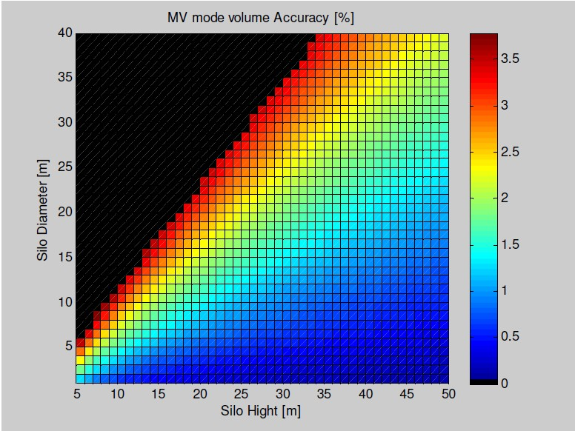
3DLevelScanner Accuracy

Slide 69
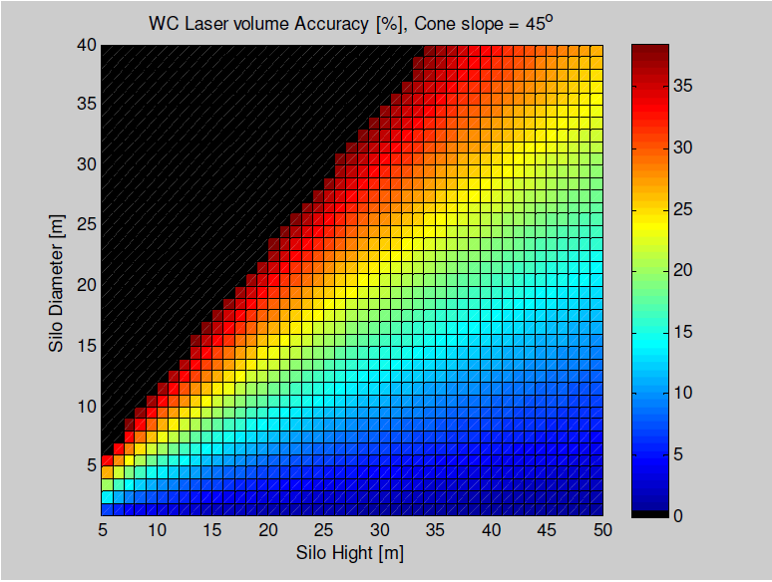
3DLevelScanner Accuracy Vs. Single Point Device Accuracy

Slide 70
Rice Silo Installation

Slide 71
3D Visualization During
Empty Cycle: #1
Inset photo shows bin contents at time of measurement.
Single point measurement devices would not reflect this irregularity in material surface.
VOLUME: 82.65%

Slide 72
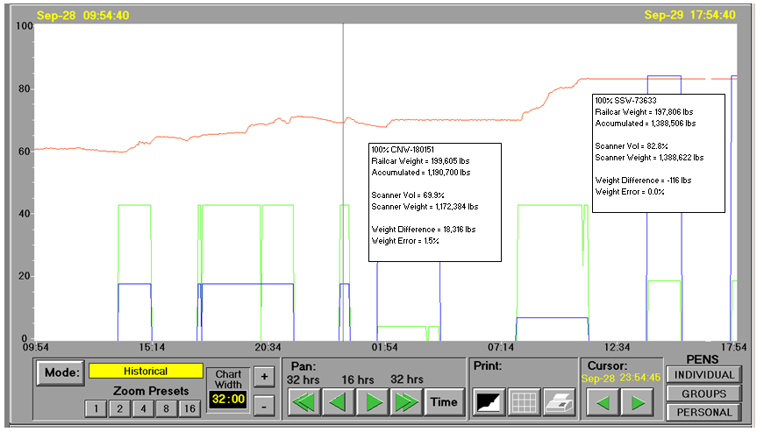
Scanner Tracking Filling Process:
Example #3
*
*
Green “highs” indicate fill process is turned on. Red line shows product volume trend. Weight error percentages (*) are based on added product volume, not total capacity volume.

